Slide 1
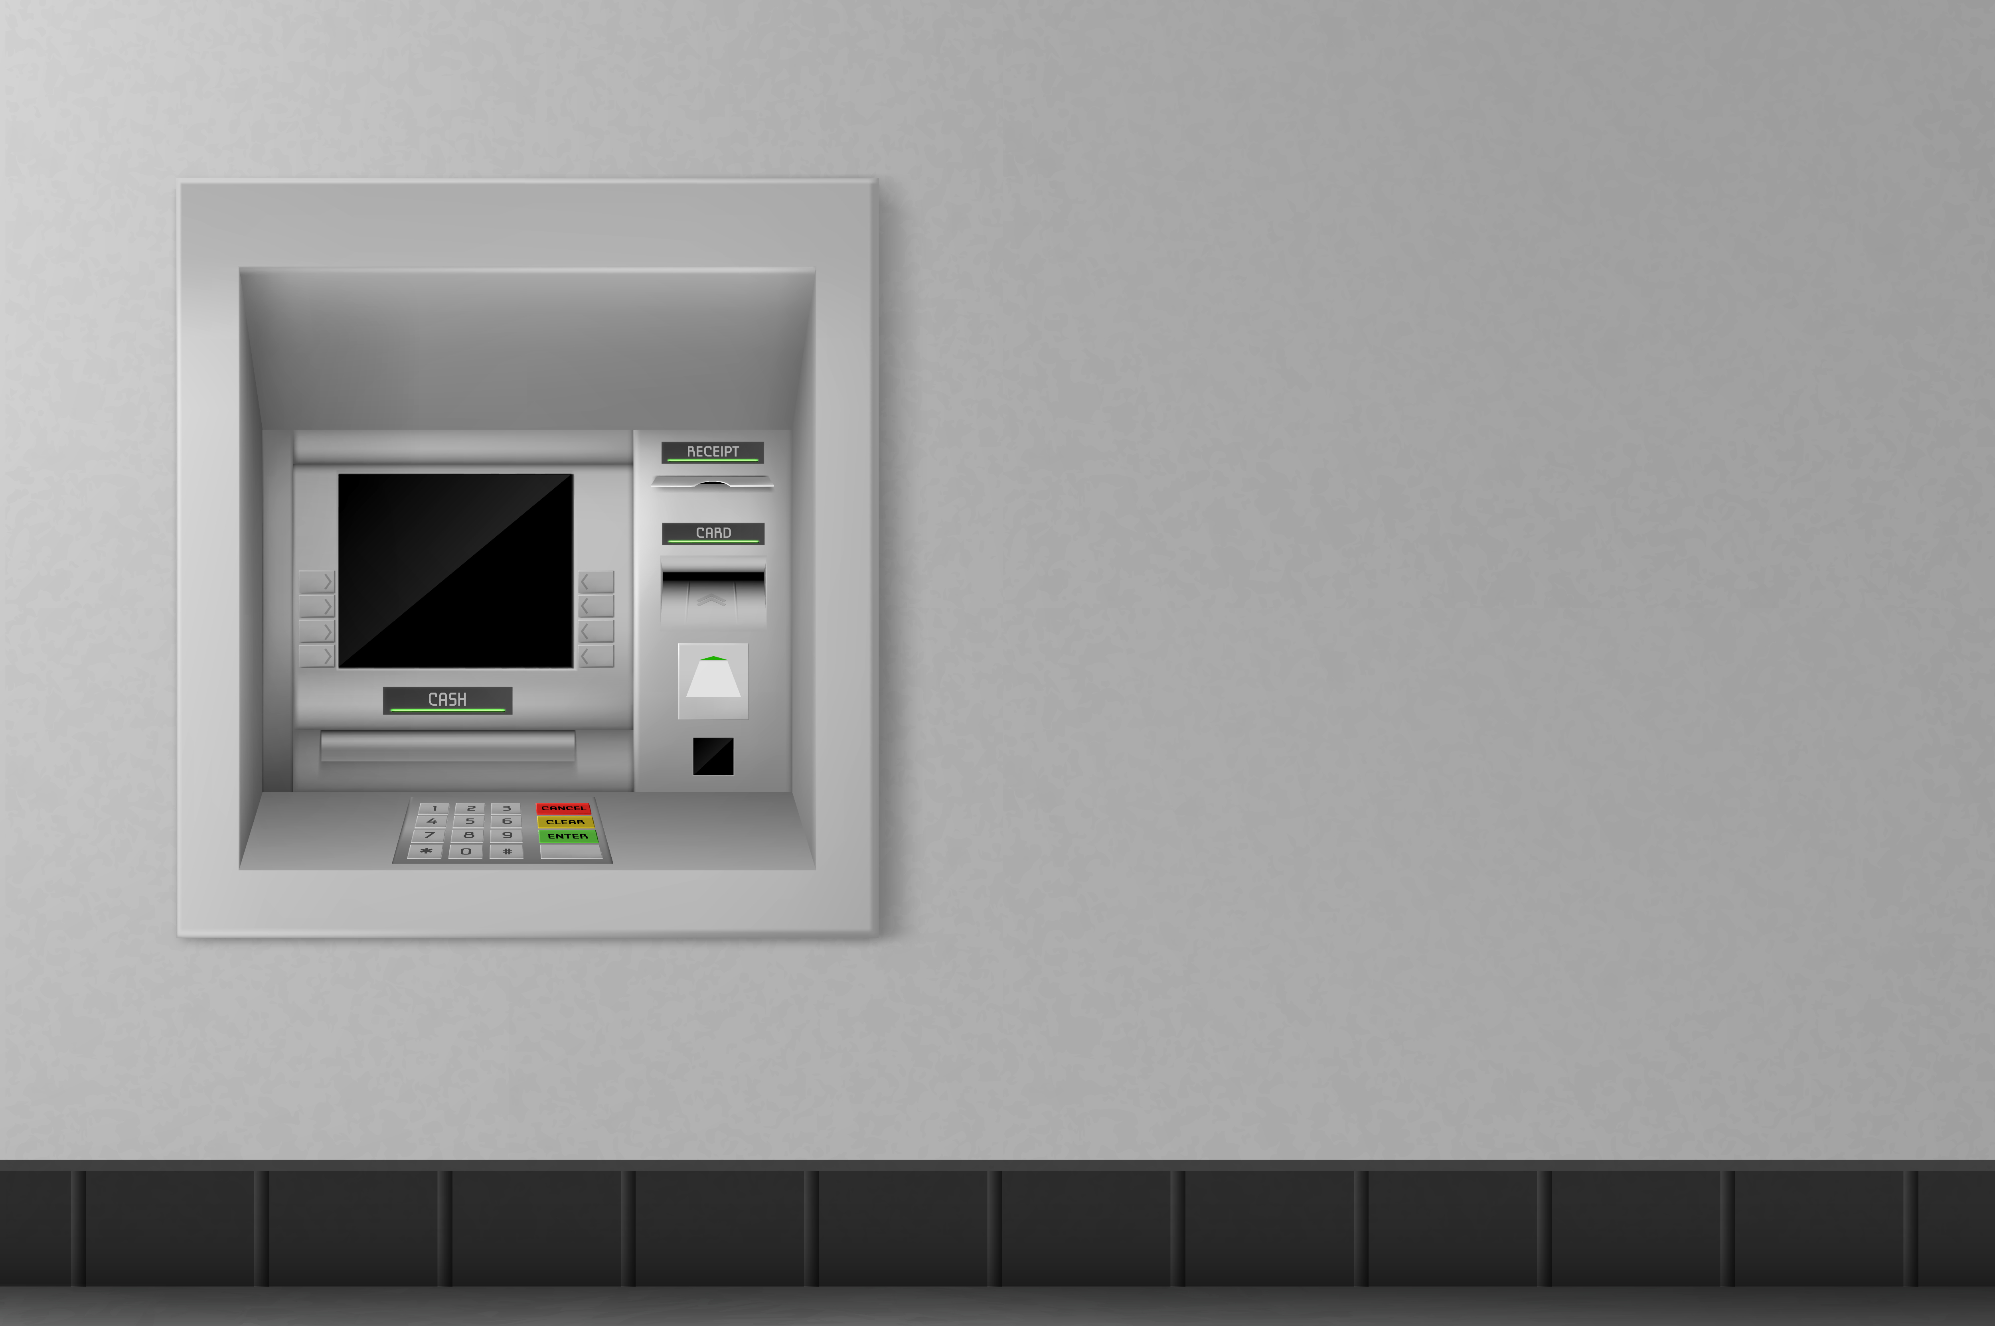

VS Solutions
Walle-tm
BRINGIN YOUR E-WALLET AND
ATM ONE STEP CLOSER
Vaibhav Verma 2k17/se/123
Shivam Chaudhary 2k17/se/108
(Group 45)

Slide 2
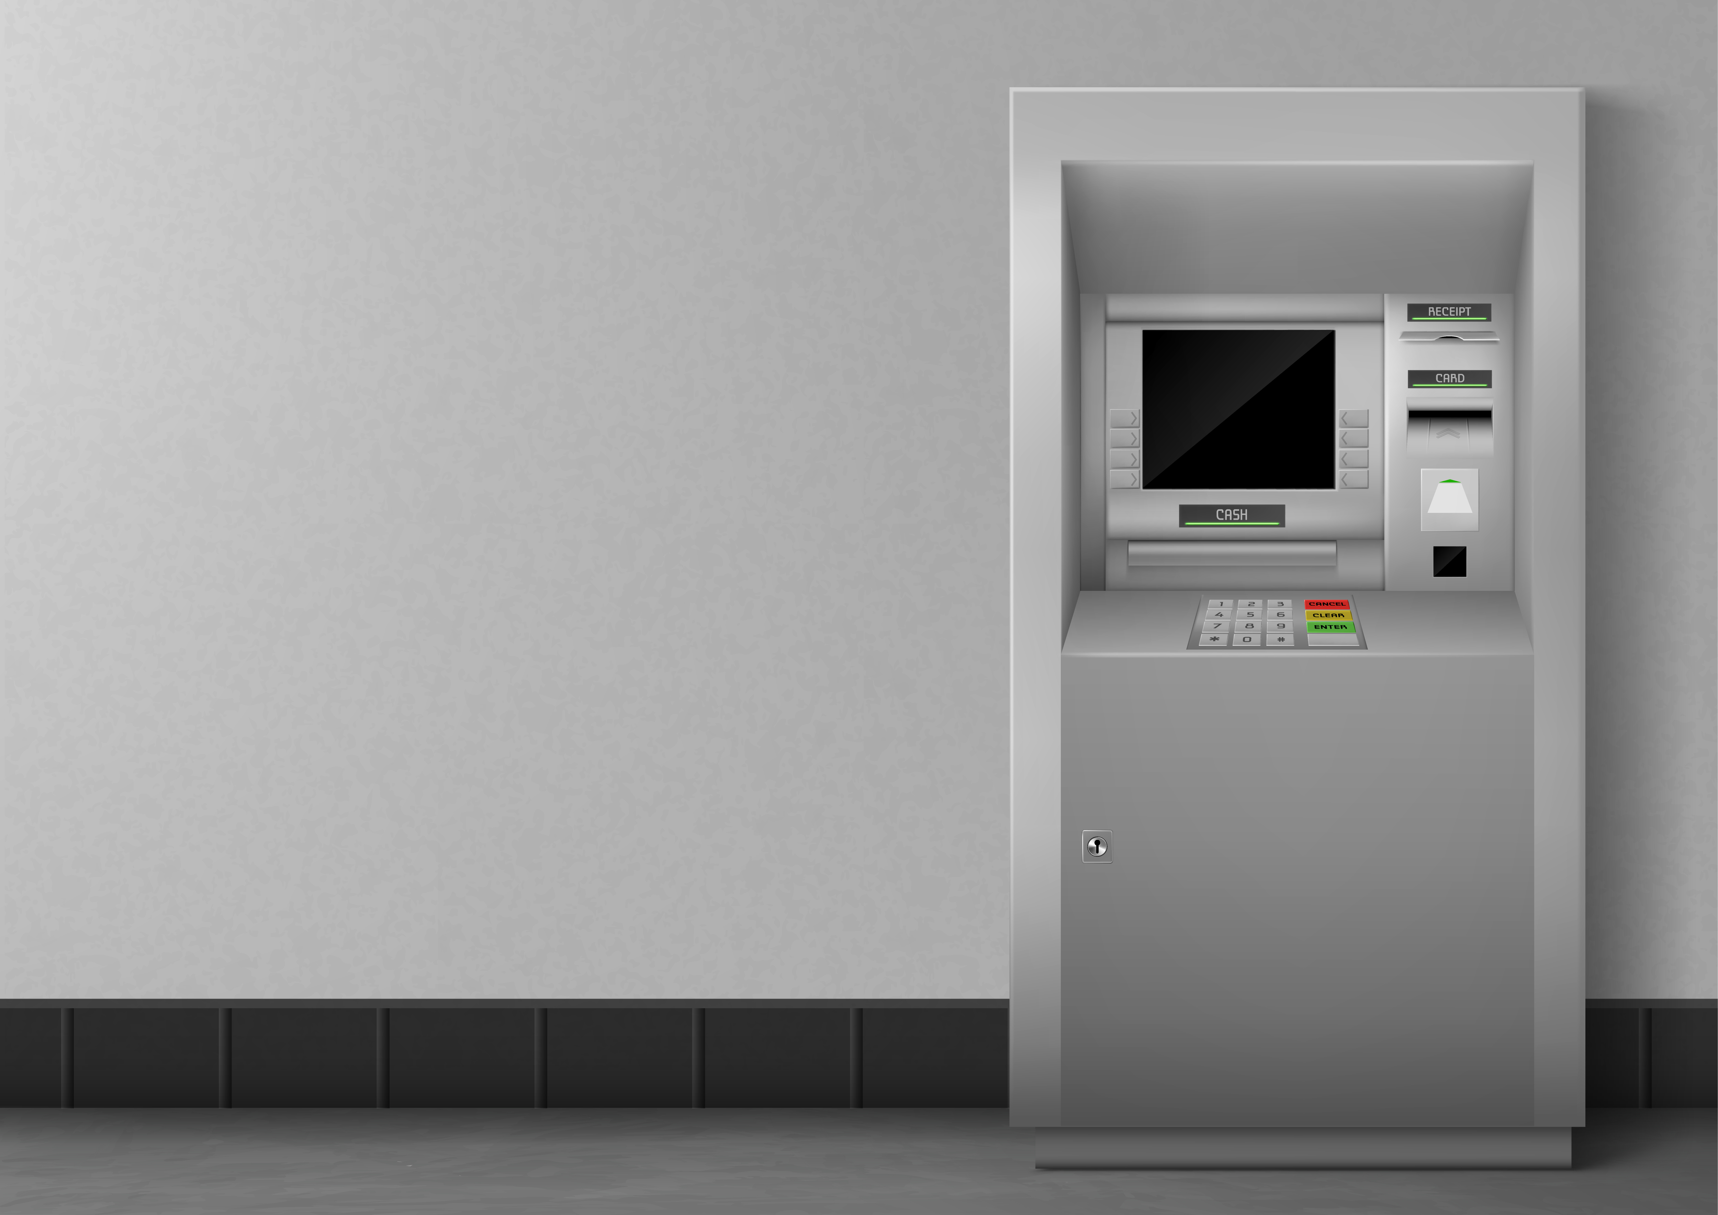
introduction
As we all know that E-wallets are now one of the most preferable and trusted payment methods and a great way to carry money online
What if you can use your E-wallet for withdrawing money from ATM machine?
Yes, here a well reputed bank and an E-wallet company have collaborated and decided to introduce this functionality by their product Walle-tm and they have hired VS solutions for this.
This could revolutionize the dynamics between Digital money and physical cash.
This also addresses another problem i.e. if you forget your debit card at home, it will not be a problem because cash withdrawal from our application doesn’t require ATM card.

Slide 3
Feasibility study
Technical Feasibility
For the front end we will use Angular9 framework.
For back-end spring will be used.
PostgreSQL will be used for maintaining the database.
AWS servers will be used.
Economic Feasibility
The initial investment will be done by both, the bank and the E-wallet company
The main source of revenue is the service charge of 6% on the total amount withdrawn by an individual.
Considering that we get 6% of the total amount withdrawn as revenue, initial investment can be easily recovered in just a few years.
We can say that our project is both Economically
and Technically Feasible

Slide 4
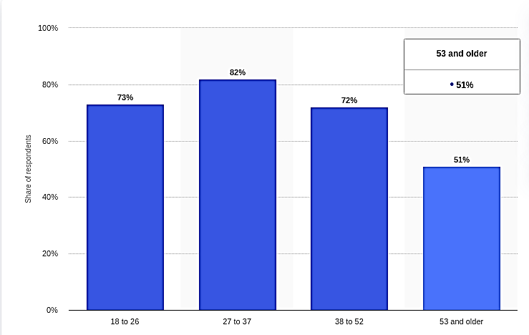
Current market situation
The number of E-wallet users have increased dramatically over the years.
These are some of the e-wallet companies having more than 100M+ downloads on Android play store:
Paytm
Google pay
Phonepe
Mobikwik
Introducing such a platform will be beneficial to all the e-wallet users and will set an example to motivate other e-wallet companies and banks to collaborate like this.
Share of consumers using mobile wallets across India as of January 2018, by age group

Slide 5
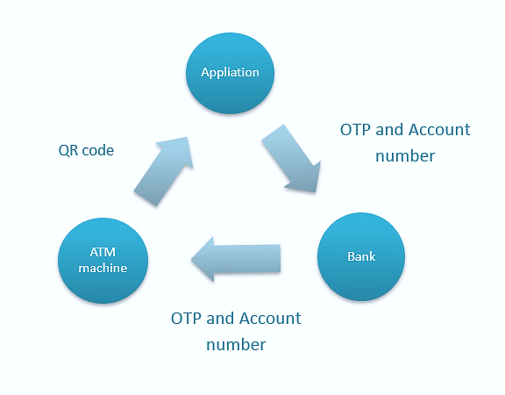
procedure
User can find a nearby ATM machine by the use of our application.
User will scan the QR code attached to the machine. Now our application will know that the user wants to withdraw cash from that particular ATM machine.
The application will generate an OTP and share it with bank and the user.
Along with OTP, user account number, serial number of ATM machine will also be shared with bank and bank in turn will share the info with the ATM machine.
As soon as the user will enter the OTP in the ATM machine, they would be authenticated.
Now, user will enter the amount to be withdrawn in the application. A total of withdrawal amount+6% of withdrawal amount will be deducted from their e-wallet and transferred to their account.
As soon as the amount gets transferred to bank account, bank will tell the ATM machine to release cash. Once the cash is ejected, user session will end.
This figure shows the flow of information between the ATM machine, Bank, Application

Slide 6
Stakeholders and their responsibilities
BANK
E-WALLET COMPANY
Establish a fast and robust connection with WALLE-TM and ATM machines.
Install QR codes for all the ATM machines.
Motivate more and more customers to use WALLE-TM.
Provide all the necessary information to the developers
Motivate the customers to link their bank account with their E-wallet.
Advertise about this new functionality.
CUSTOMERS
VS SOLUTIONS
Give proper feedback to the concerned team for the betterment of the software.
Do not try to misuse the machine i.e. not having the required amount and still trying to withdraw money. The software will handle this case anyway.
Build an efficient design for the Application.
Generate robust O.T.P.
The user interface should be easy to understand for every age group.

Slide 7
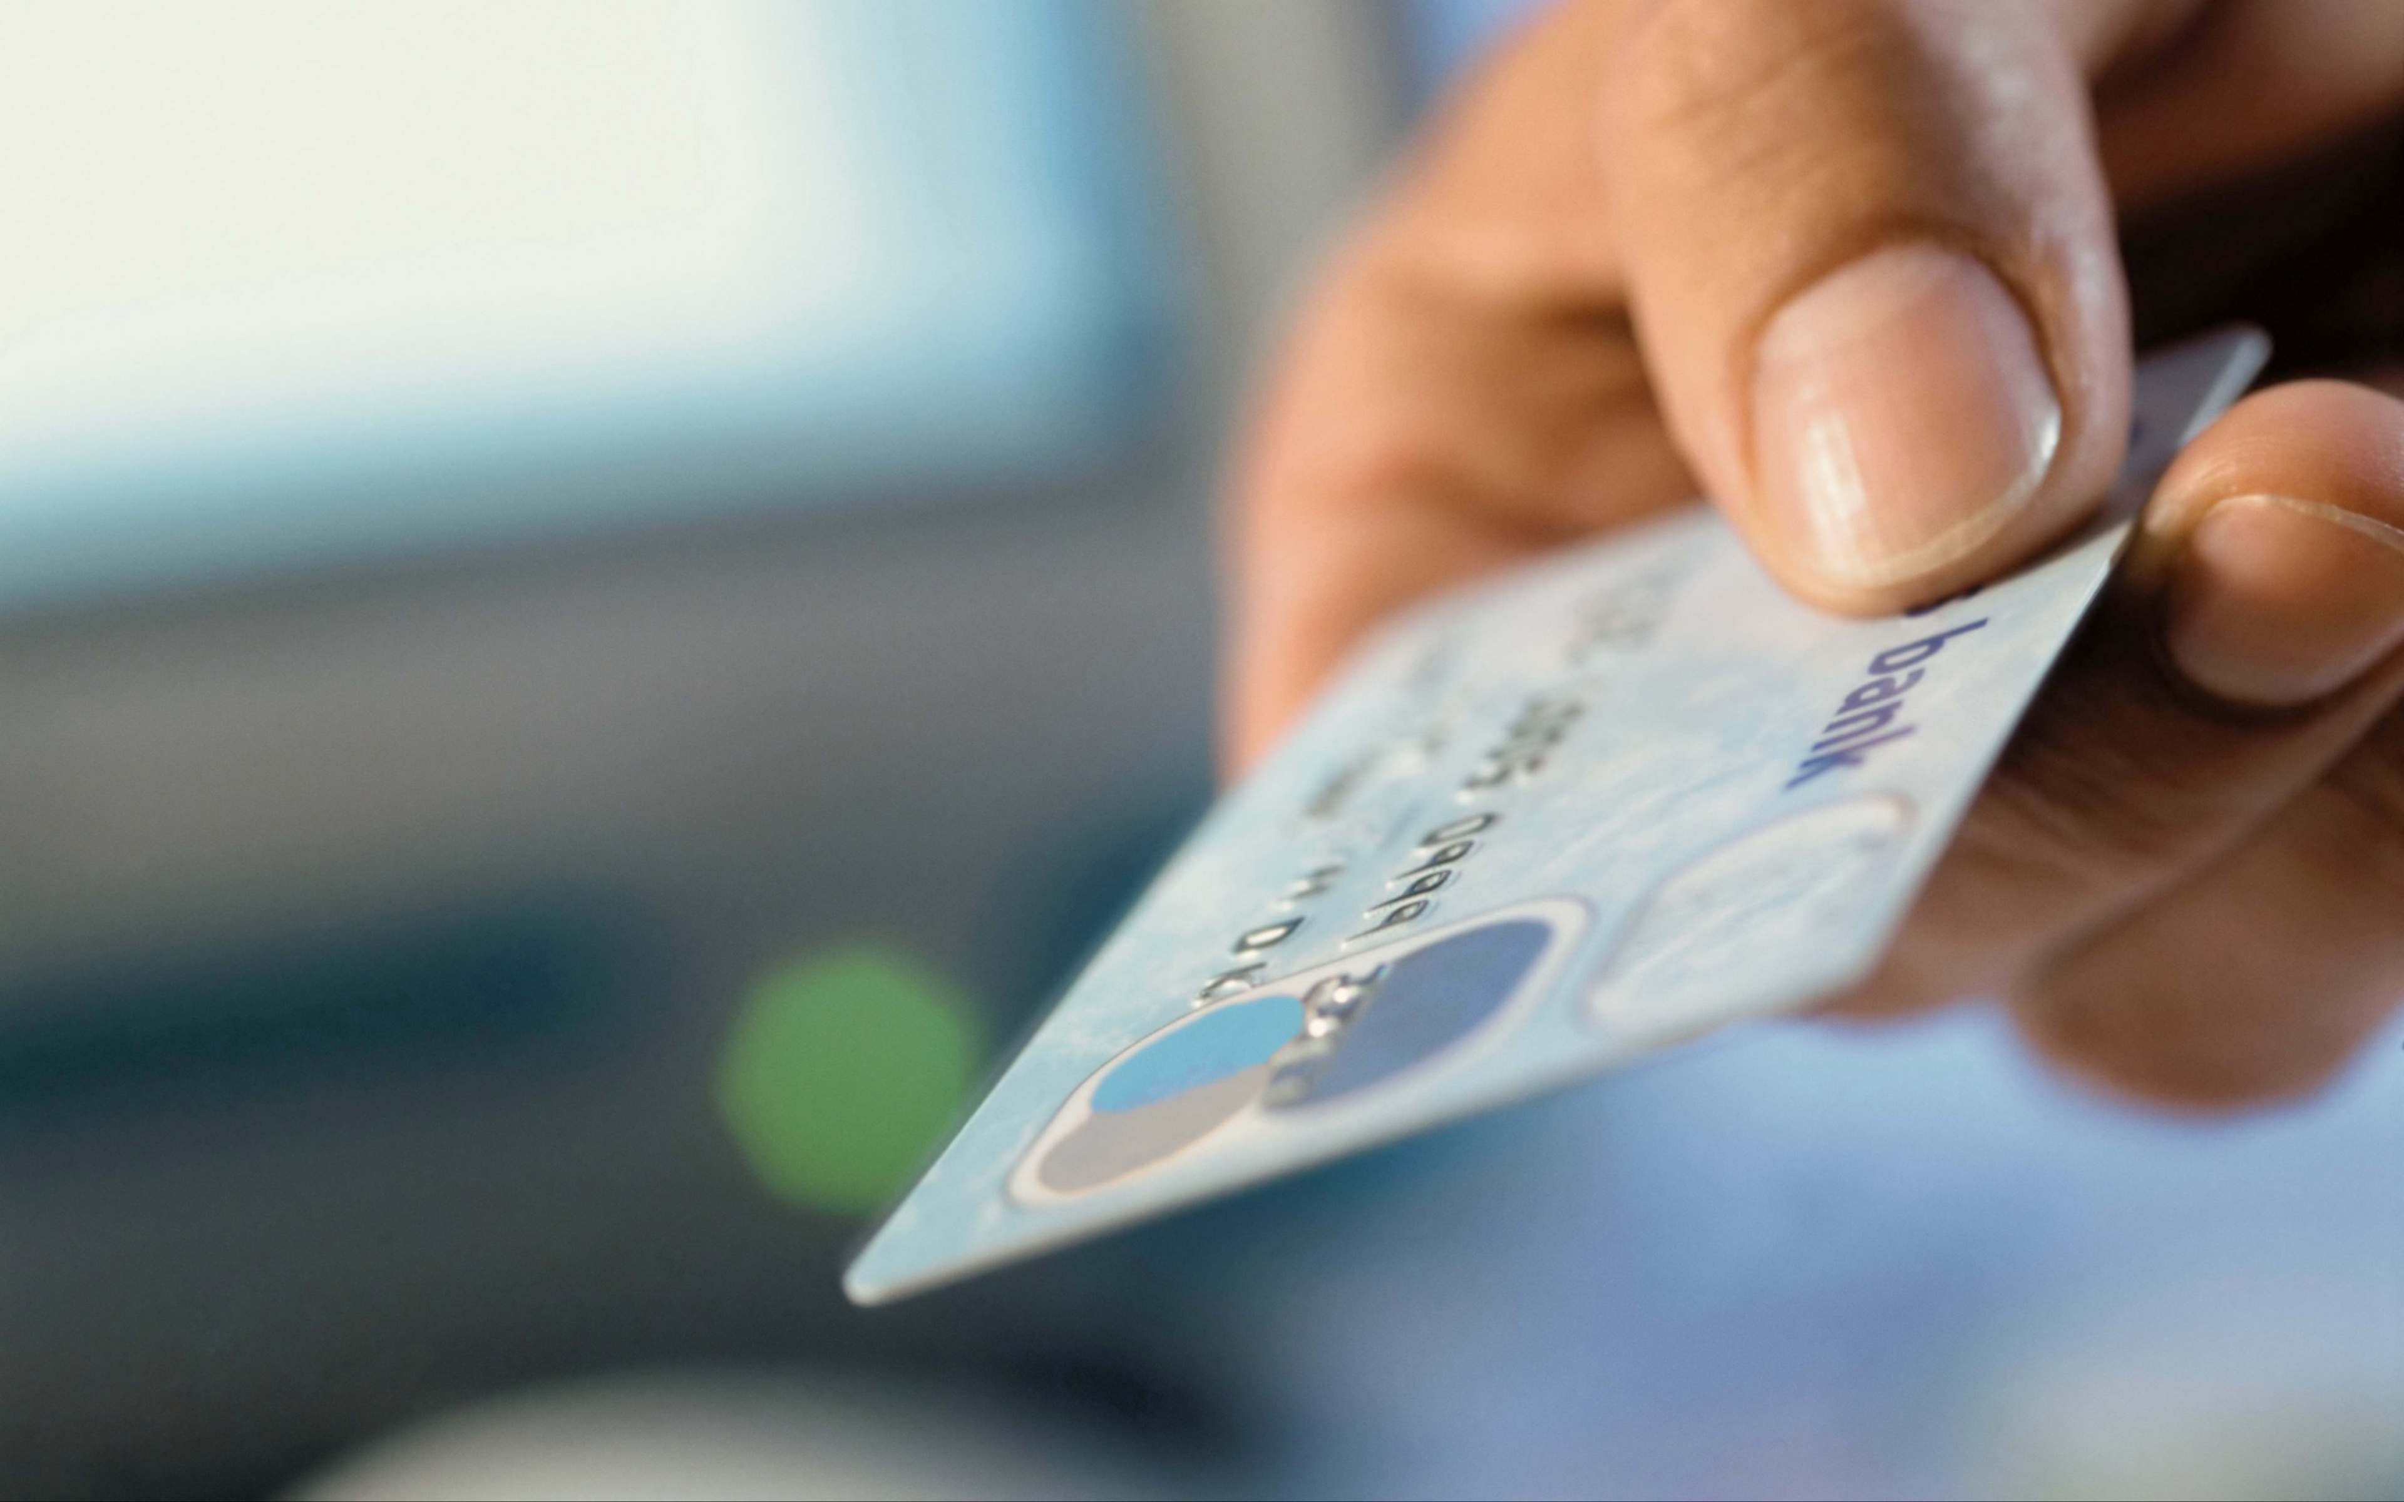
Activities and their duration
Activity | Description | Duration (weeks)
A | Feasibility study | 4
B | Obtain requirements | 6
C | Product analysis | 2
D | Product design | 4
E | Develop database | 2
F | ATM machine upgradation | 8
G | Implementation | 10
H | Testing | 4
I | Advertisement | 2
J | Deployment | 2

Slide 8
RESOURCE ESTIMATION
FUNCTION POINT ANALYSIS:
ILF = 17
EIF = 21
External Input = 9
External Output = 17
User Enquiries = 20
UFP = 84
CAF = 1.19
FPA = 100
Functional Unit | Count | Complexity | Complexity total | Functional Unit Total
External Inputs (EI) | 1 | Low * 3 | 3 | 17
 | 2 | Average * 4 | 8
 | 1 | High * 6 | 6
External Outputs (EO) | 1 | Low * 4 | 4 | 21
 | 2 | Average * 5 | 10
 | 1 | High * 7 | 7
External Inquiries (EI) | 1 | Low * 3 | 3 | 9
 | 0 | Average * 4 | 0
 | 1 | High * 6 | 6
Internal Logical Files (ILF) | 1 | Low * 7 | 7 | 17
 | 1 | Average * 10 | 10
 | 0 | High * 15 | 0
External Interface Files (EIF) | 2 | Low * 5 | 10 | 20
 | 0 | Average * 7 | 0
 | 1 | High * 10 | 10
Using the total number of Functional Points and considering our main language as JAVA the SLOC calculated is: 5KLOC

Slide 9
RESOURCE ESTIMATION
SEL MODEL:
Effort : 6.25 Person-Month
Duration : 6.99 Months
Person Required : 1 Person
Productivity : 0.8 KLOC/Person-month
WALSTON FELIX MODEL:
Effort : 22.5 Person-Month
Duration : 7.32 Month
Person Required : 3 Persons
Productivity : 0.22 KLOC/Person-Month
BASIC COCOMO MODEL:
Effort : 13 Person - months
Duration: 6.62 Months
Person Required: 2 Persons
Productivity: 0.38 KLOC / Person-Months
INTERMEDIATE COCOMO MODEL:
EAF: 1.214
Effort = 13 X EAF = 15.78 person-months
Duration = c*(Effort)^{d} = 7.13 months.
Person required : 2 Persons
Productivity : 0.31 KLOC/Person-Months

Slide 10
RESOURCE ESTIMATION
DETAILED COCOMO MODEL
PHASE-WISE EFFORT:
Planning and Requirements: 0.94 Person-Months
System Design: 2.52 Person-Months
Detail Design: 4.10 Person-Months
Module Code and Test: 6.62 Person-Months
Integration and Test: 2.50 Person-Months
PHASE-WISE DEVELOPMENT TIME:
Planning and Requirements: 0.70 Months
System Design: 1.30 Months
Detail Design: 1.71 Months
Module Code and Test: 2.78 Months
Integration and Test: 1.28 Months

Slide 11
RESOURCE ESTIMATION
COCOMO II MODEL
OBJECT ORIENTED SIZE ESTIMATION MODEL
EARLY DESIGN MODEL:
B = 0.91 + 0.01* 7.29 = 0.98
PM nominal = 2.5*5^{0.98} = 12.10 Person-Month
Effort multiplier = 1.01
PM adjusted = PM nominal * Effort multiplier
PM adjusted = 12.221 Person-Months.
USE CASE POINT METHOD:
UUCW = 170
UAW = 8
UUCP = 178
TCF = 0.6 + 0.49 = 1.09
ECF = 1.13
UCP = 178 X 1.09 X 1.13 = 219.24
Effort = 4384 Person Hour

Slide 12
RISK ANALYSIS
S. No | Problem | Probability of occurrence of a problem | Impact of The problem | Risk exposure | Priority
R1 | Coding takes longer than expected. | 4 | 6 | 24 | 2
R2 | Team members get ill (Covid infected). | 6 | 5 | 30 | 1
R3 | Design is not robust. | 2 | 9 | 18 | 4
R4 | Documentation is improper. | 2 | 4 | 8 | 11
R5 | Change in Requirement during implementation | 4 | 4 | 16 | 5
R6 | Testing reveals a lot of bugs. | 1 | 9 | 9 | 10
R7 | Lack of experience causes delays in projects. | 2 | 10 | 20 | 3
R8 | User interface might be complicated for some age group | 3 | 4 | 12 | 8
R9 | Real time performance shortfall | 1 | 7 | 7 | 12
R10 | Technologies used might get outdated. | 3 | 5 | 15 | 6
R11 | Clashes in ideologies of Bank and e-wallet company. | 2 | 3 | 6 | 13
R12 | Security should be robust | 1 | 10 | 10 | 9
R13 | Another competitor might appear with a better idea. | 2 | 7 | 14 | 7
R14 | App crashes due to heavy load (Scalability issues). | 1 | 5 | 5 | 14

Slide 13
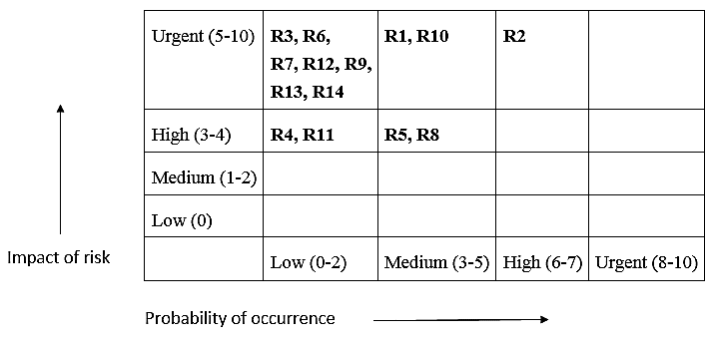
Risk matrix

Slide 14

Risk mitigation techniques
S.No | Problem | Risk mitigation techniques
R1 | Coding takes longer than expected. | Maintaining checkpoints with projected time for each section of code. Motivating the developers to give their 100%
R2 | Team members get ill (Covid infected). | Regular health check-ups for staff. Maintaining proper hygiene at the workplace.
R3 | Design is not robust. | Do all the design related checks prior to finalizing the design Proper verification of Deliverables with performance estimation
R6 | Testing reveals a lot of bugs. | After developing each unit do a little unit testing to ensure the unit doesn’t contain too many bugs.
R7 | Lack of experience causes delays in projects. | Make sure that the staff is well experienced. Proper training of Staff on technologies used.
R9 | Real time performance shortfall | Run several kinds of simulations before deploying the product. Do not make unattainable claims about the performance.
R10 | Technologies used might get outdated. | Do a proper brainstorming session with all the team members about which technologies to use.
R12 | Security should be robust, otherwise, the system gets susceptible to hackers. | Hire ethical hackers for testing system security.
R14 | App crashes due to heavy load (Scalability issues). | Make the system highly scalable as, the number of transactions involved will be very large.

Slide 15

Monitoring the project

Slide 16
schedule of activities
Activity | Description | Required Predecessor | Duration (months)
A | 4 | - | 2
B | 6 | - | 3
C | 2 | B | 1
D | 4 | C | 2
E | 2 | B | 1
F | 8 | A | 4
G | 10 | D, E | 5
H | 4 | G, F | 2
I | 2 | H | 1
J | 2 | I | 1

Slide 17
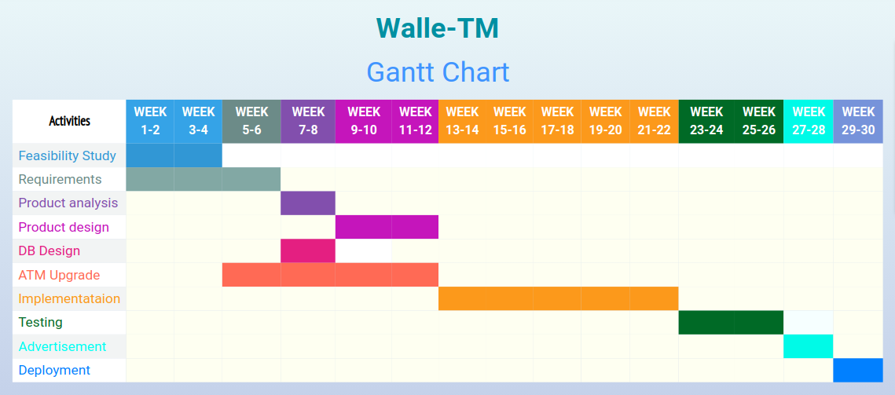

Slide 18
Table after forward and backward pass
Activity | Duration (Weeks) | Earliest Start date | Earliest End date | Latest Start Date | Latest End Date
A | 4 | 0 | 4 | 0 | 4
B | 6 | 0 | 6 | 0 | 6
C | 2 | 6 | 8 | 6 | 8
D | 4 | 8 | 12 | 8 | 12
E | 2 | 6 | 8 | 10 | 12
F | 8 | 4 | 12 | 14 | 22
G | 10 | 12 | 22 | 12 | 22
H | 4 | 22 | 26 | 22 | 26
I | 2 | 26 | 28 | 26 | 28
J | 2 | 28 | 30 | 28 | 30

Slide 19
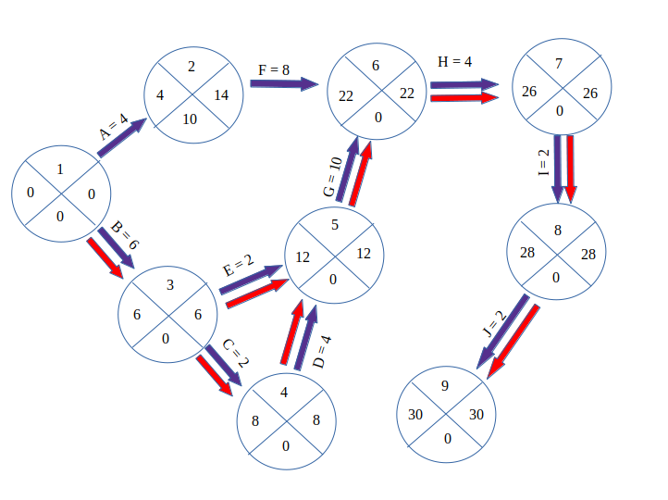
CPM CHART
Critical Paths:
1 – 3 – 4 – 5 – 6 – 7 – 8 – 9
1 – 3 – 5 – 6 – 7 – 8 – 9

Slide 20
Pert TECHNIQUE
Activity | Description | Optimistic (a) | Most Likely (m) | Pessimistic (b) | T | Standard Deviation (SD)
A | Feasibility Study | 3 | 4 | 5 | 4 | 0.33
B | Obtain Requirements | 4 | 6 | 7 | 5.83 | 0.50
C | Product Analysis | 1.5 | 2 | 3 | 2.08 | 0.25
D | Product Design | 2.5 | 4 | 5 | 3.91 | 0.83
E | Develop database | 1 | 2 | 4 | 2.16 | 0.50
F | ATM Upgradation | 6 | 8 | 9 | 7.83 | 0.50
G | Implementation | 8 | 10 | 11 | 9.83 | 0.50
H | Testing | 3 | 4 | 5 | 4 | 0.33
I | Advertisement | 1.5 | 2 | 3 | 2.08 | 0.25
J | Deployment | 1 | 2 | 3 | 2 | 0.33

Slide 21
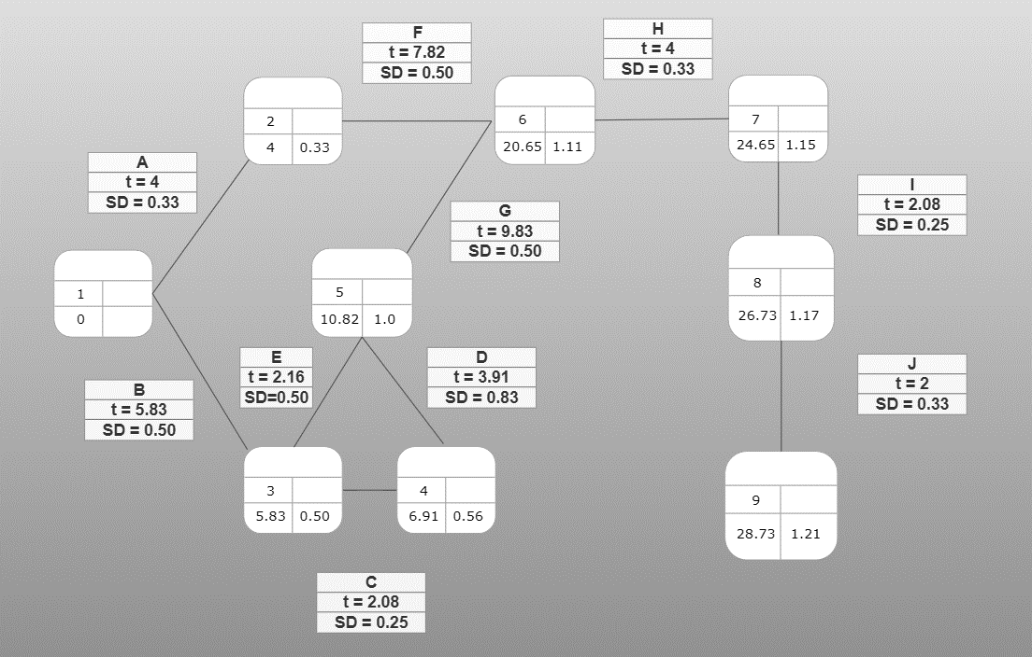
PERT CHART
TT = 30 weeks
Z = (TT – t)/ SD
Z = 1.05.
Probability of completion of project on time = 85.31%
Risk = 14.59 %
TT = 31 weeks
Z = (TT – t)/ SD
Z = 1.88.
Probability of completion of project on time = 97%
Risk = 3%

Slide 22
Cost benefit analysis
We are assuming that as of now there are 2 lakh customers which use both the bank and the e-wallet and have done their KYC.
This is the expenditure assumed for next 5 years: Year1 - 50,000 Year2 - 60,000 Year3 - 50,000 Year4 - 40,000 Year5 - 50,000
We are assuming that on average, a customer will withdraw an amount of Rs 100. So, for next 5 years total profit will be: Year1 (20% of the user will use this application for withdrawal): 2,80,000 - 50,000 = 2,30,000 Year2 (30% of the user will use this application for withdrawal): 4,20,000 - 60,000 = 3,60,000 Year3 (28% of the user will use this application for withdrawal): 3,92,000 - 50,000 = 3,42,000 Year4 (35% of the user will use this application for withdrawal): 4,90,000 - 40,000 = 4,50,000 Year5 (42% of the user will use this application for withdrawal): 5,88,000 - 50,000 = 5,38,000

Slide 23
Cost benefit analysis
Year | Cash Flow | Discount Factor (8%) | Discounted Cash Flow
0 | -7,00,000 | 1.00 | -7,00,000
1 | 2,30,000 | 0.9259 | 2,12,957
2 | 3,60,000 | 0.8573 | 3,08,628
3 | 3,42,000 | 0.7938 | 2,71,480
4 | 4,50,000 | 0.7350 | 3,30,750
5 | 5,38,000 | 0.6806 | 3,66,163
Net Profit | 12,20,000 | NPV | 7,89,978
Net Profit: sum of cash flow over all 5 years = 12,20,000.
RETURN on INVESTMENT: ROI = Average Annual Profit / Total Investment * 100 = 34%
Net Present Value: Sum of all discounted cash flows = 7,89,978.

Slide 24
conclusion
This is a new project, so it is very difficult to predict its outcome but, this will inspire a lot of entrepreneurs to try their hands in this field
There are a few things which we can try if this project gets successful which are: 1. Not mandating the customer to have account in the partner bank in order to withdraw money. 2. Making a unified E-wallet which can interact with ATM machine of any bank. 3. Instead of making it a two way process(amount first goes into user’s bank account and then it is withdrawn) we can directly use the amount in the E- wallet to withdraw the money

Slide 25

Thank you !!!

